Slide 1
NBA Game Probability Prediction
Colin McKhann

Slide 2

Motivations of the project
NBA considered a “stars”-oriented league
Recently (and historically) successful teams feature a few very good players (i.e. Michael Jordan, Lebron James, Giannis Antetokounmpo, etc.)
Additionally, team building has become more statistic-oriented:
If teams can “predict” the qualities of a winning team through data-driven decisions, why can’t we?
How well can success be projected just from this one player, as well as their whole team

Slide 3
Goal:
Create model that evaluates whether player will win based on statistical performance
Combine individual player percentages to generate team results

Slide 4


Preprocessing
Data comes from 2021-22 NBA Season
Structured within two dataframes: One containing the result of the team, and one containing the individual player’s statistics for each game.
Removed all games in which players did not play
Created columns to track whether player won

Slide 5
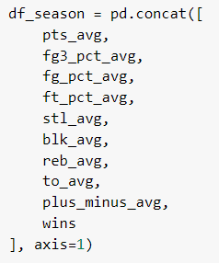
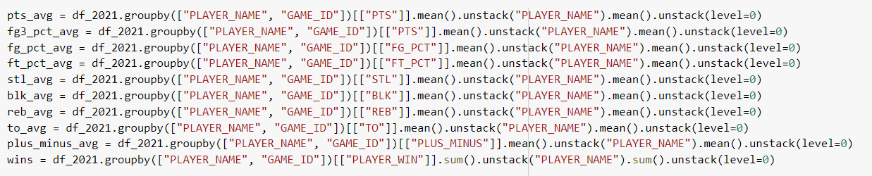
Preprocessing
Converted individual game statistics to season average statistics
Created column tracking total amount of wins over season
Converted whether the player won or lost into a categorical variable
One-hot encoded categorical training variables

Slide 6

Model Information
2 models tested: MLPClassifier and LogisticRegressor
MLPClassifier contained 3 hidden layers of size 16, 8, and 4
Used ReLU for activation, SGD for solver
Hyperparameter tuned using RandomizedSearchCV

Slide 7


Model Results
MLPClassifier:
LogisticRegression:
LogisticRegression performed comparably to the neural network, so it will be used for the next part of the project

Slide 8
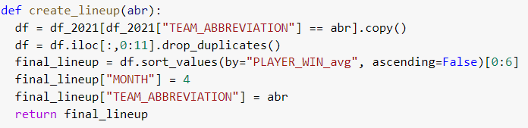
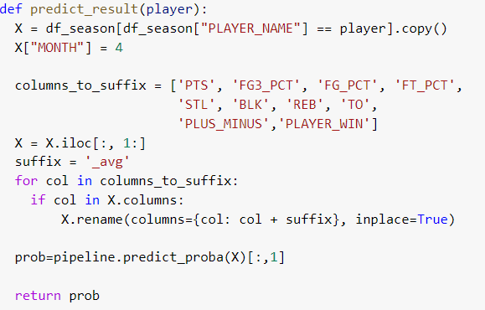
Combining Results for Teams (functions)

Slide 9
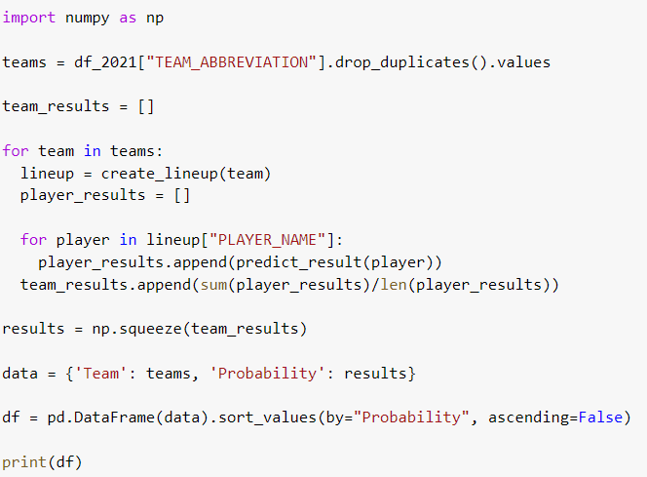
Generating player results for each team

Slide 10
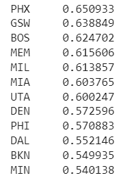
Results
Team predictions fairly in line with real NBA playoff results
Two finals teams (Golden State and Boston) near the top of rankings despite not having the highest regular season results
Correctly predicted the quarter final teams
Note: model ranked Utah and Denver higher, but both lost to higher projected teams
Still some wrong guesses, such as the Suns having the highest projection

Slide 11
Lessons/Future Improvements
Through only a single player a fairly high-odds can be made
More season data should be included
Implement more weighting for players with higher win totals
Try more models to maximize improvement
Incorporate predictions for multiple players
Eventually scale to consider full starting-5 rosters against each other to project winner
Test more advanced statistics (offensive/defensive rating, usage rate, true shooting, etc.)

